Slide 1
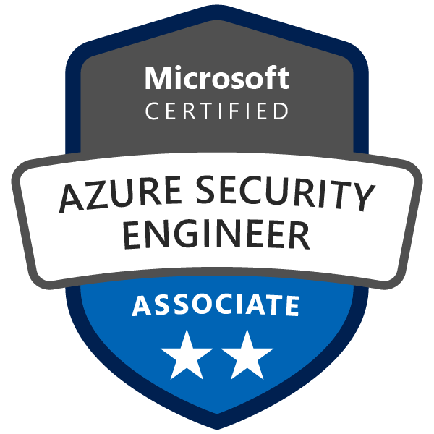
Exam AZ-500: Microsoft Azure Security Technologies Crash Course
Tim Warner

Slide 2


Tim Warner
Based in Nashville, TN, US
MCT, MVP
Twitter: @TechTrainerTim
Badge: timw.info

Slide 3
Course Materials
timw.info/az500

Slide 4
Session 1 of 2 Learning Goals
Introduction
Manage identity and access
Administer Azure AD security
Configure Azure AD PIM
Implement platform protection
Configure network, container, host security
Manage security operations
Configure Azure Security Center

Slide 5
Session 2 of 2 Learning Goals
Manage security operations, continued
Configure Azure DevOps
Configure security policies
Configure security alerts
Secure data and applications
Configure data classification
Protect data infrastructure
Configure application security and Key Vault

Slide 6
Setting Expectations
The job role in play is the Azure Security Administrator
Identify which security controls are available for different Azure products and know their configuration basics
This is a "crash course"
Plan to review these materials more than once
Five-minute break at midpoint
Please ask/answer questions and provide feedback in the Q/A panel, not the group chat

Slide 7
2020 Certification Updates
Microsoft Worldwide Learning reviews each role-based certification yearly
Exam AZ-500 was updated on July 29, 2020
Review the "Skills Measured" document: https://timw.info/500sm
Themes:
Eliminated redundancy with other exams
Reorganized outline
Azure Sentinel
Removed references to legacy technologies (HDInsight)

Slide 8
Tim's Certification Study Pyramid
Interdependence
Content knowledge
Practical application
Test-taking skills

Slide 9
Manage Identity and Access

Slide 10


Azure AD and Subscriptions

Slide 11
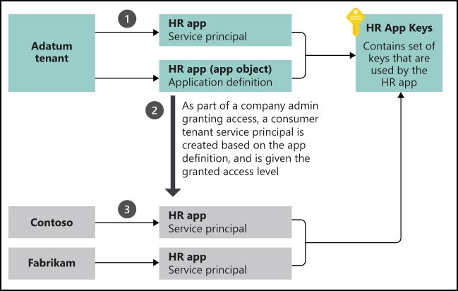
App registrations and service principals

Slide 12

Azure AD B2C

Slide 13

Azure AD Domain Services

Slide 14

Azure AD SSO

Slide 15

Passthrough Authentication

Slide 16

Seamless Single Sign-On

Slide 17

AD FS Federation

Slide 18
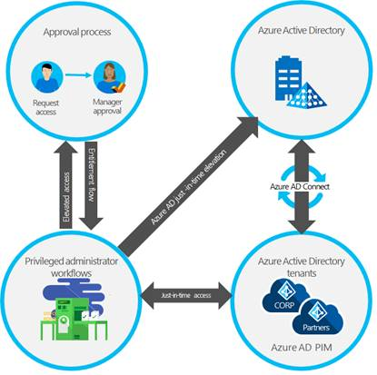
Azure AD PIM

Slide 19
Implement Platform Protection

Slide 20
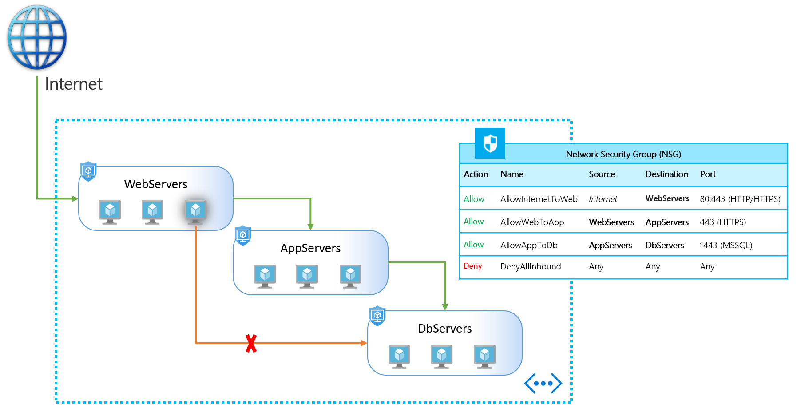
NSGs and ASGs

Slide 21

VM High Availability

Slide 22

Web App High Availability

Slide 23
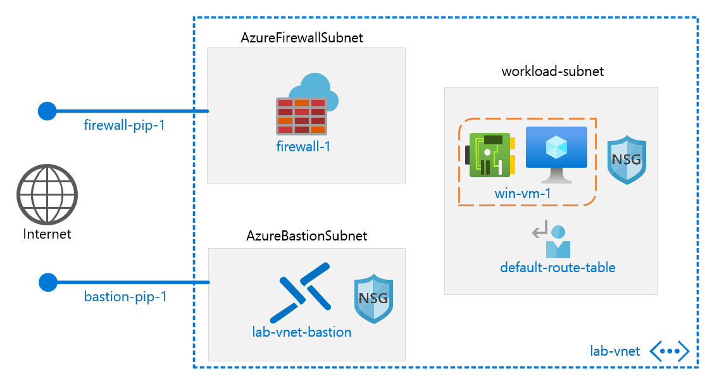
Azure Firewall

Slide 24
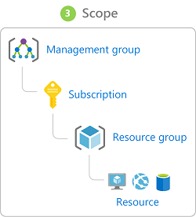
Azure Management Scopes
/ Tenant Root

Slide 25

Service endpoints

Slide 26
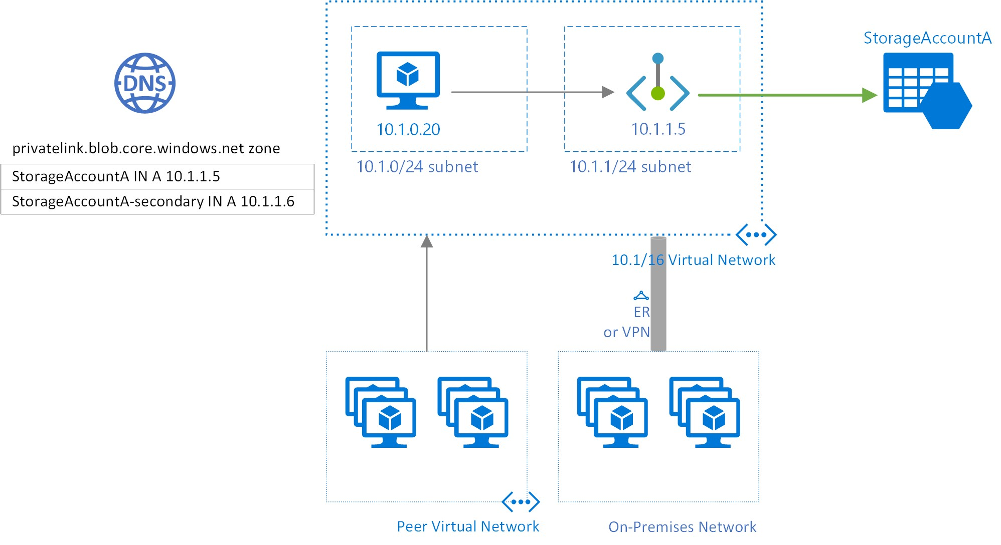
Private endpoints

Slide 27
Manage Security Operations

Slide 28
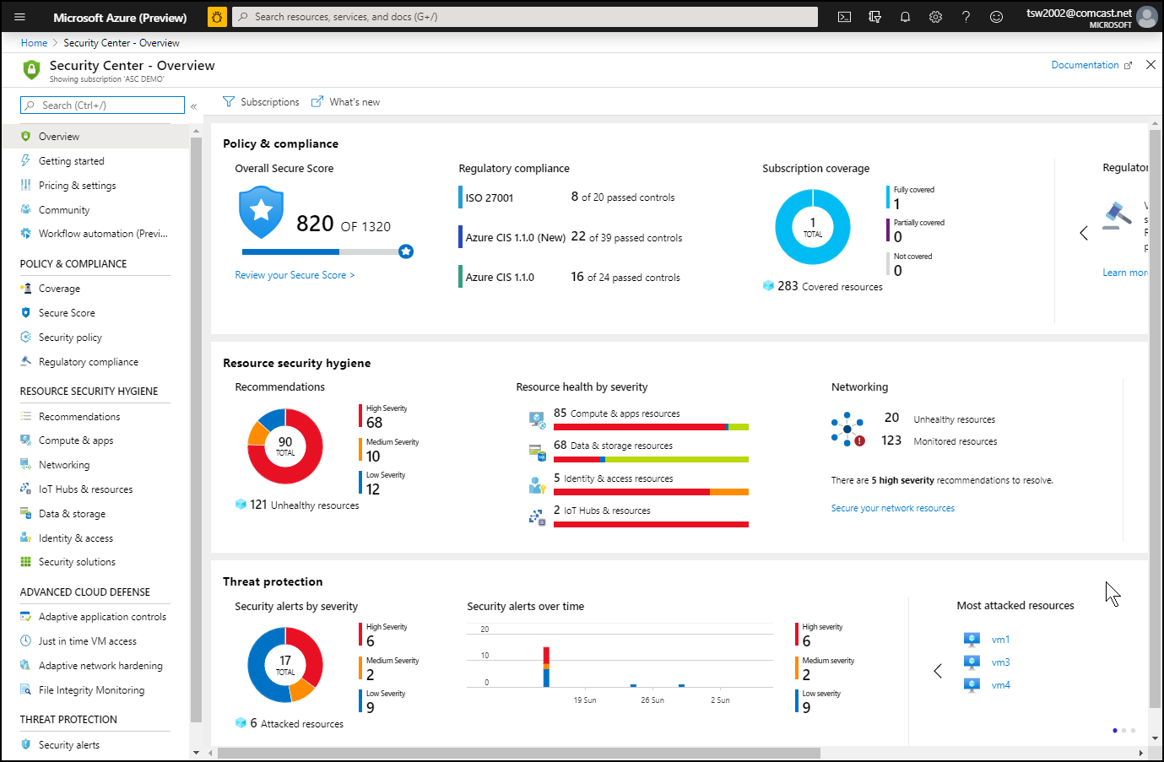
Azure Security Center

Slide 29
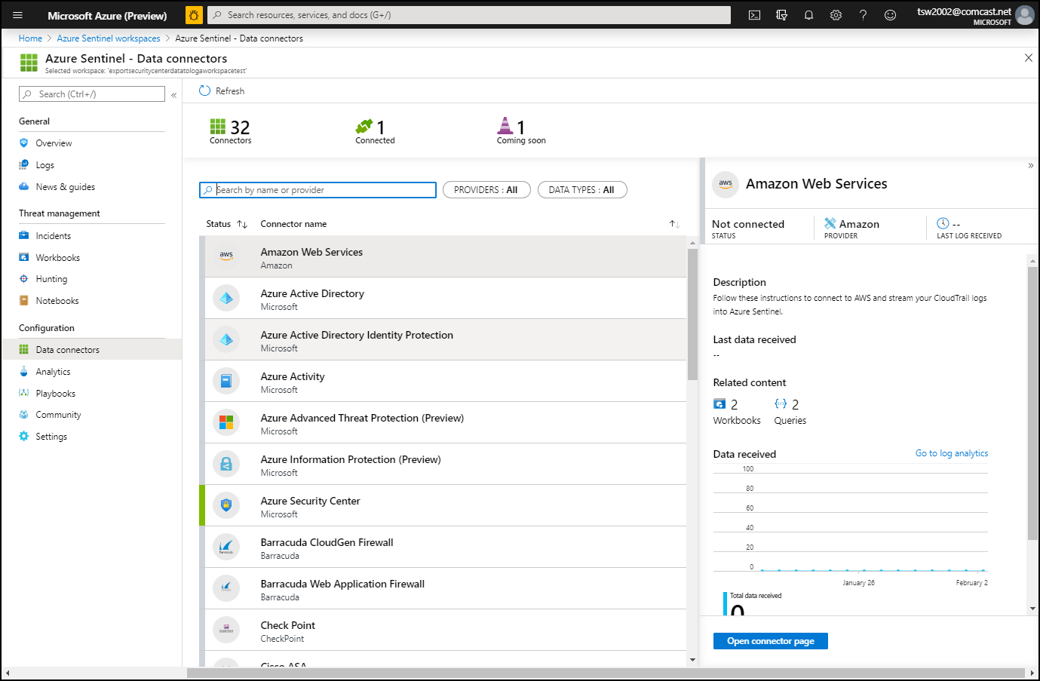
Azure Sentinel

Slide 30
Secure Data and Applications

Slide 31
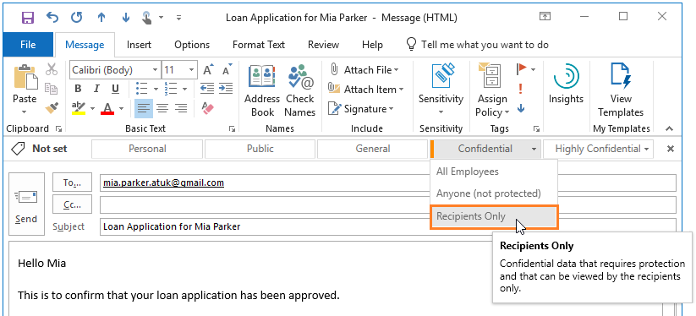
Azure Information Protection

Slide 32
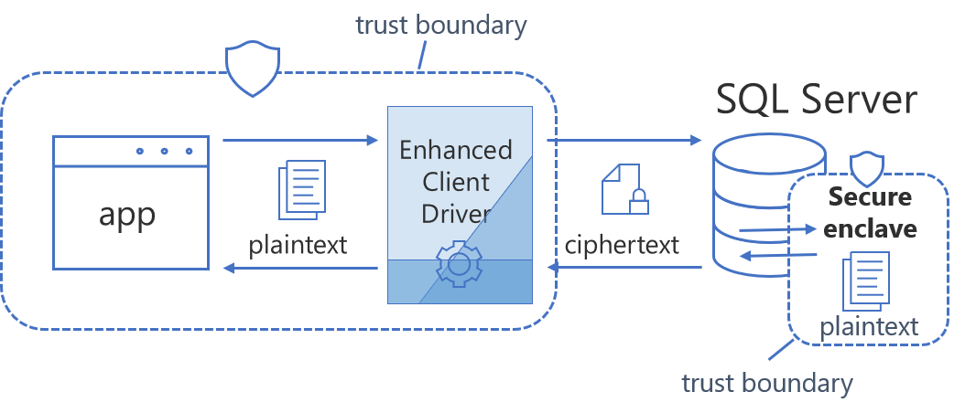
Always Encrypted

Slide 33
Exam AZ-500 Item Types

Slide 34

Single Answer Multiple Choice

Slide 35

Multiple Answer Multiple Choice

Slide 36
Repeated Scenario
You need to move an Azure VM to another hardware host.
Solution: You redeploy the VM.
Does this solution meet the goal?
Yes
No

Slide 37
Repeated Scenario
You need to move an Azure VM to another hardware host.
Solution: You enable boot diagnostics.
Does this solution meet the goal?
Yes
No

Slide 38

Select and Place

Slide 39

Build List and Reorder

Slide 40

Active Screen/Fill in the Blank

Slide 41

Case Study

Slide 42






Performance-Based Lab

Slide 43
Microsoft Online Testing

Slide 44

Microsoft Online Testing Process

Slide 45

Microsoft Online Testing Process

Slide 46

Microsoft Online Testing Process

Slide 47

Microsoft Online Testing Process

Slide 48

Microsoft Online Testing Process

Slide 49

Microsoft Online Testing Process

Slide 50

Microsoft Online Testing Process

Slide 51
AZ-500 Exam Strategy
Focus your skills accordingly:
60 percent Azure portal
20 percent Azure PowerShell
10 percent Azure CLI
10 percent KQL
Azure AD PIM all day long
Expect performance-based labs, but be happy if you don't see 'em

Slide 52
Thank you!
Course materials: timw.info/az500
Twitter: @TechTrainerTim
Work: timw.info/ps
Web: timw.info

